Slide 1
The Intersection of African Culture and Modern IT: A Symbiotic Relationship
Exploring the Role of Technology in Preserving and Promoting African Cultural Heritage

Slide 2
INTRO’
Here is an outline for a presentation titled "The Intersection of African Culture and Modern IT: A Symbiotic Relationship." This will demonstrate how African culture has influenced the development of technology and how IT can support the preservation and promotion of African culture.
STEPHEN MWANGI WAHOME
C026-010-0990/2021

Slide 3
AFRICAN CULTURES
African tribes are highly diverse, with each community possessing its unique language, customs, and traditions. There are an estimated 3,000 distinct ethnic groups in Africa, each with its own unique culture. Tribal communities vary greatly in terms of size, with some numbering in the thousands, while others are made up of just a few hundred people.
This diversity is what dominates the African culture both in Africa and in the African diaspora.

Slide 4
INFORMATION AND COMMUNICATION
Information and communications technology (ICT) is an extensional term for information technology (IT) that stresses the role of unified communications[1] and the integration of telecommunications (telephone lines and wireless signals) and computers, as well as necessary enterprise software, middleware, storage and audiovisual, that enable users to access, store, transmit, understand and manipulate information.

Slide 5
1. African Oral Tradition and Digital Storytelling
Oral Tradition: The role of storytelling in African cultures as a means of preserving history, teaching morals, and entertaining.
African storytelling has been used to interpret the universe, resolve natural and physical phenomena, teach morals, maintain cultural values, pass on methods of survival, and to praise God (Ngugi wa Thiong'o 1986, Vambe.)

Slide 6
How IT digitize oral traditions
Digital Storytelling: How IT is used to digitize these oral traditions, making them accessible to a global audience.
Digital storytelling utilizes modern technologies such as videos, audio recordings, and interactive platforms to capture the essence of these age-old tales, preserving them for future generations. By embracing multimedia elements, you can experience folklore in a more immersive and engaging manner.
Example: The "African Storybook" project, which creates open access stories in multiple African languages, combining traditional stories with modern technology.

Slide 7
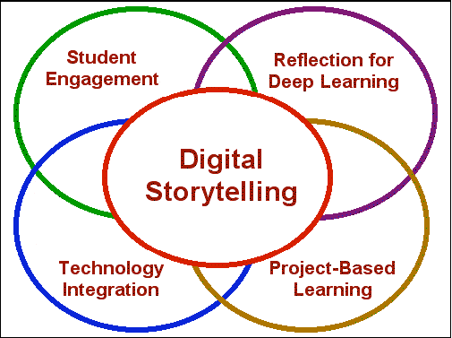
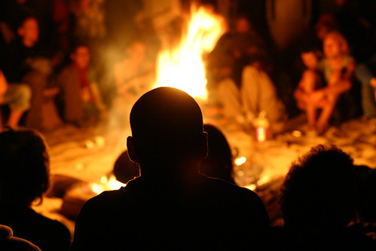
THE EVOLUTION OF STORY TELLIING

Slide 8
African Languages and Natural Language Processing (NLP)
Linguistic Diversity: Africa's linguistic richness with over 2,000 languages.
NLP in African Languages: Challenges and progress in developing AI models that understand and process African languages.
Example: Google Translate and African language integration, and the Masakhane project that focuses on NLP for African languages.

Slide 9
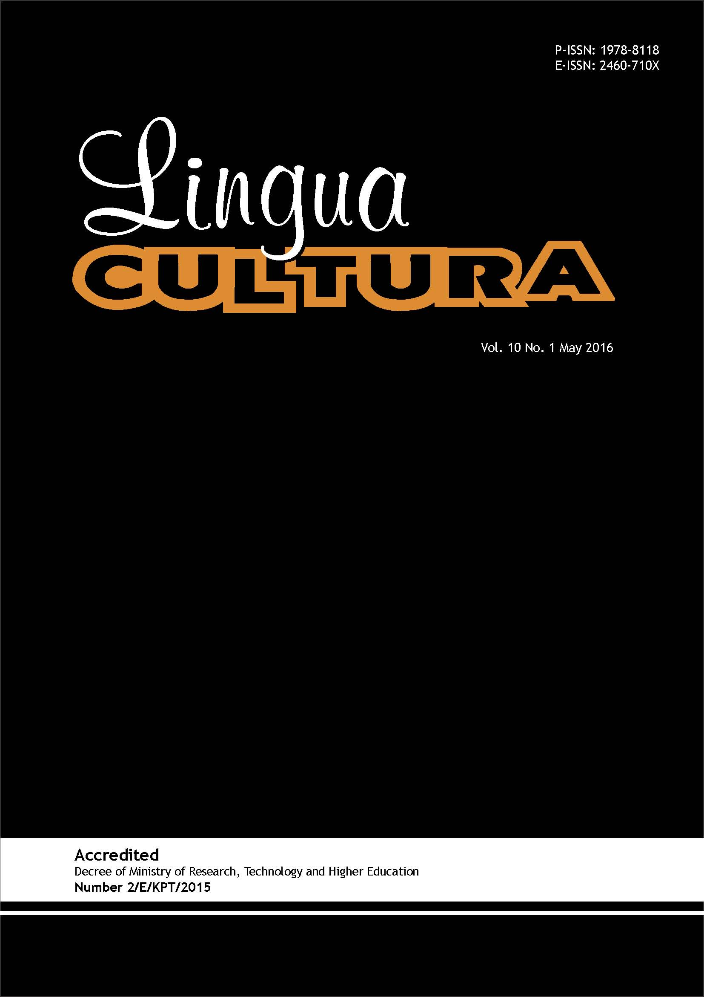
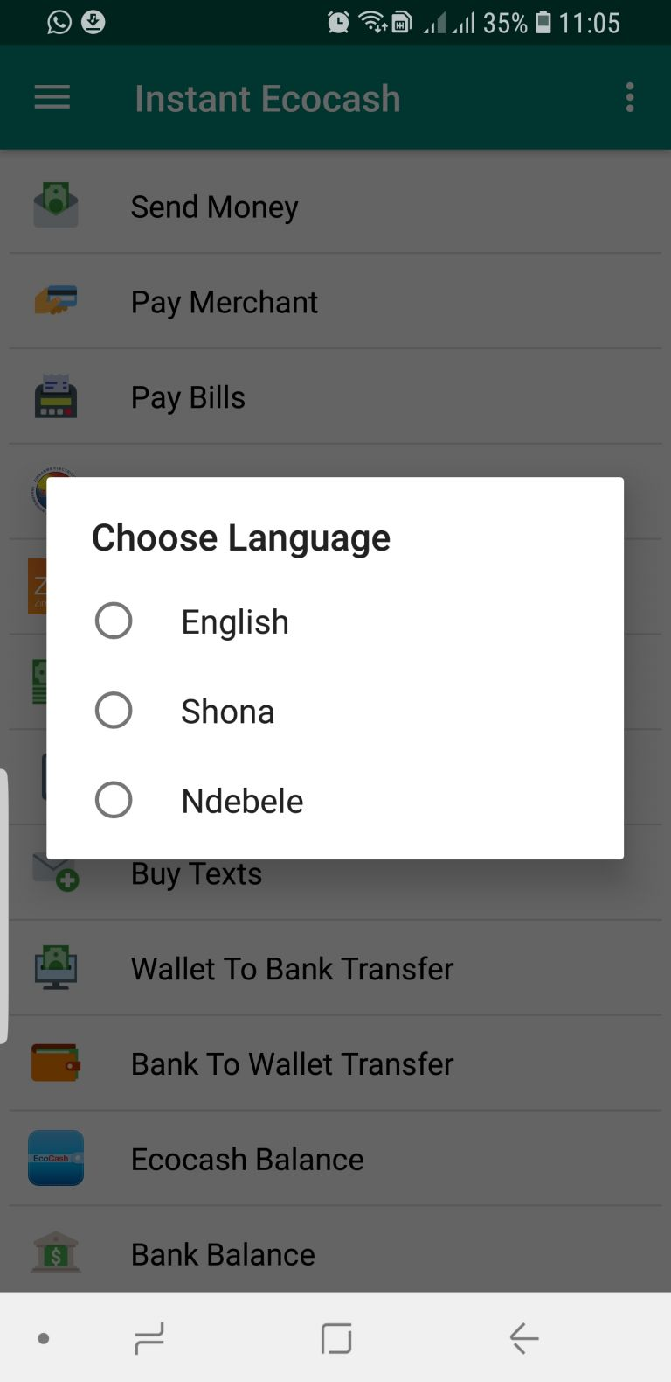
Use of local language of devices

Slide 10
Indigenous Knowledge Systems and Knowledge Management
Indigenous Knowledge: Importance of traditional knowledge in areas such as agriculture, medicine, and environmental management.
IT Integration: How knowledge management systems are being developed to preserve and share indigenous knowledge.
Example: The use of Geographic Information Systems (GIS) in mapping traditional land use and resources.

Slide 11
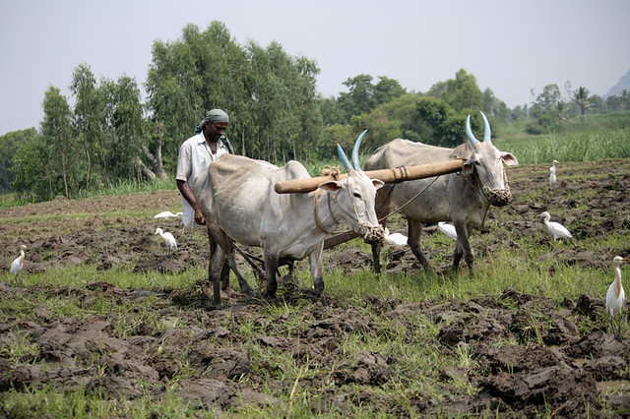
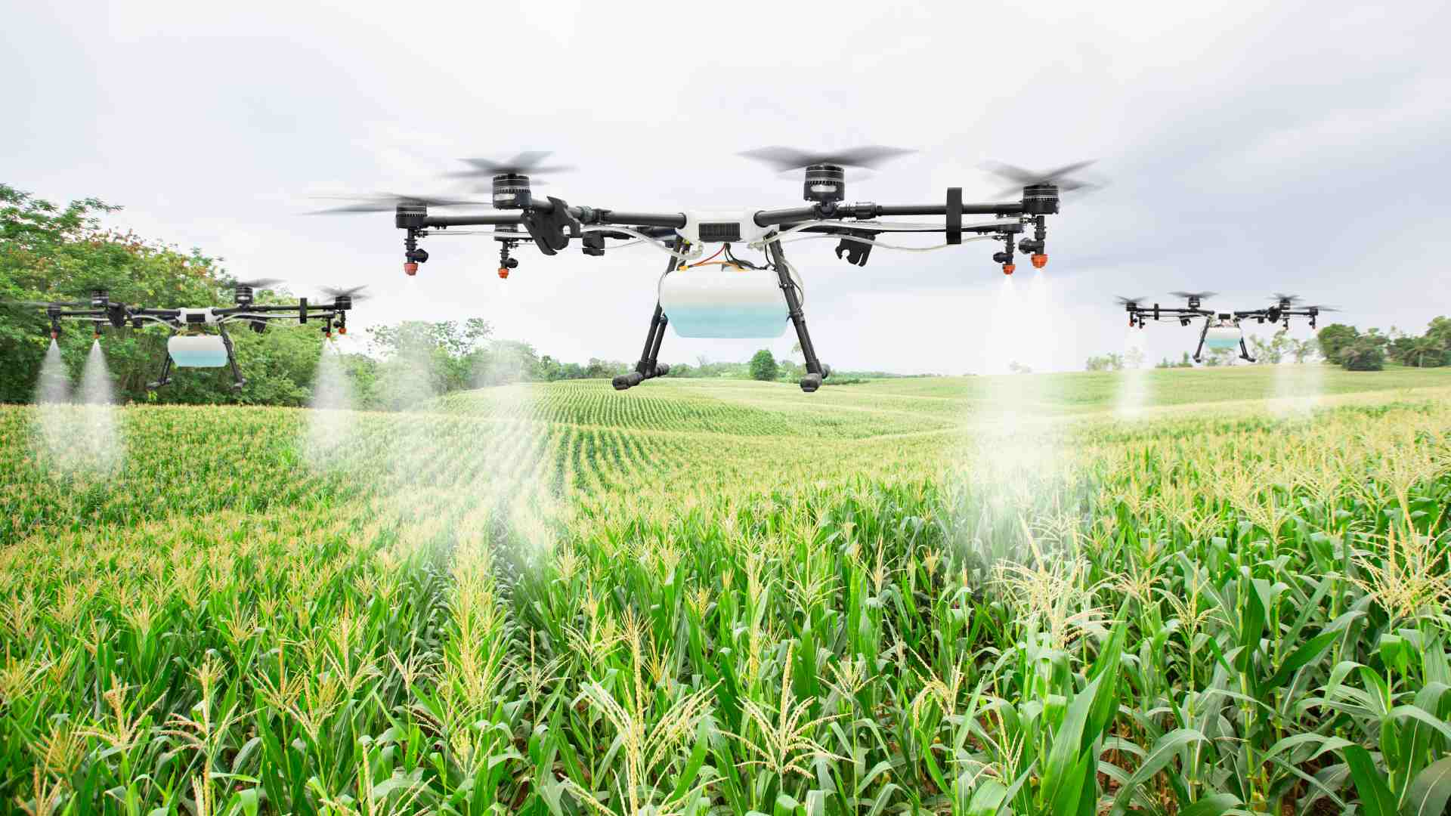
IMAPCT OF INDEGINOUS KNOWLEDGE IN ICT - AGRICULTURE
Use of ICT in Agriculture. Traditional agricultural methods revolutionize the growth of ICT

Slide 12
Cybersecurity and African Cultural Contexts
Cultural Awareness in Cybersecurity: Understanding local cultural practices and how they influence cybersecurity practices.
Example: The role of traditional conflict resolution methods in developing community-based cybersecurity strategies.

Slide 13
Mobile Technology and Social Change
Mobile Penetration: The impact of mobile technology on social, economic, and cultural development in Africa.
Cultural Adaptation: How mobile apps are adapted to meet cultural needs, including mobile banking (M-Pesa) and education platforms.
Example: M-Pesa's role in financial inclusion and how it respects local customs and practices.

Slide 14
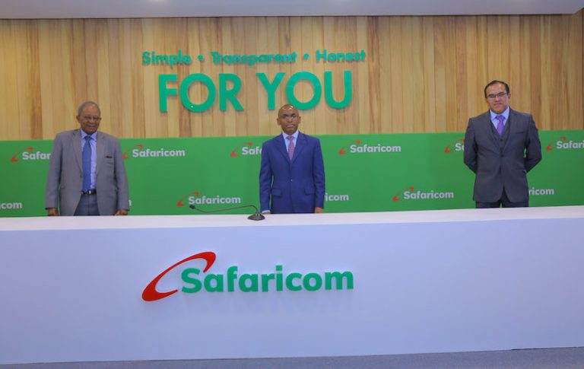

Cyber security borrows from peoples traditions to ensure that it upholds people’s dignity
M-PESA holds the values of being simple, honest and transparent to it’s customers

Slide 15
E-Commerce and African Artisans
E-Commerce Platforms: How IT enables artisans to reach global markets.
Traditional Crafts: The role of artisans in preserving cultural crafts and arts.
E-Commerce Platforms: How IT enables artisans to reach global markets.
Example: Platforms like Afrikrea, which supports African fashion designers, artists, and craftsmen by providing them with an online marketplace.

Slide 16
Cultural Heritage Preservation through Digital Archiving
Cultural Heritage: The significance of artifacts, music, dance, and other forms of cultural expression.
Digital Archiving: Use of IT to create digital repositories that preserve these cultural elements for future generations.
Example: The Timbuktu Manuscripts digitization project, preserving ancient manuscripts in Mali.

Slide 17
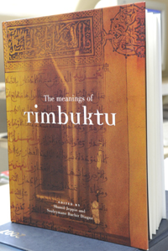
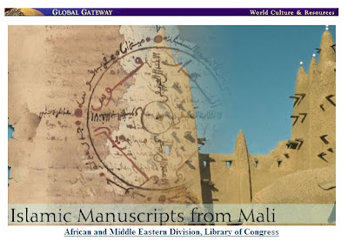
The Timbuktu Manuscripts

Slide 18
CONCLUSION
The impact of African culture on ICT cannot be overemphasized. African culture has revolutionized ICT dictating its shape and evolution.
Example of areas where its impact is felt include:
Cybersecurity – The advent of cyber security has to draw its essence from African culture. Otherwise the general mankind dignity will be out of the picture.
Indigenous knowledge – The rise of ICT in Agriculture heavily borrows from the traditional African indigenous practices.
Story telling – Modern literature borrows heavily from African culture. In a view to preserve the traditions of a given community , modern ways of digital story telling allow better retention of culture.

Slide 19
REFERENCES
https://en.wikipedia.org/wiki/Culture_of_Africa
http://www.scielo.org.za/scielo.php?script=sci_arttext&pid=S1561-40182015000200006
https://www.ssbfnet.com/ojs/index.php/ijrbs/article/view/2662
https://www.idos-research.de/uploads/media/DP__3.2019_01.pdf
https://www.sciencedirect.com/science/article/abs/pii/S0736585316300715

